Slide 1
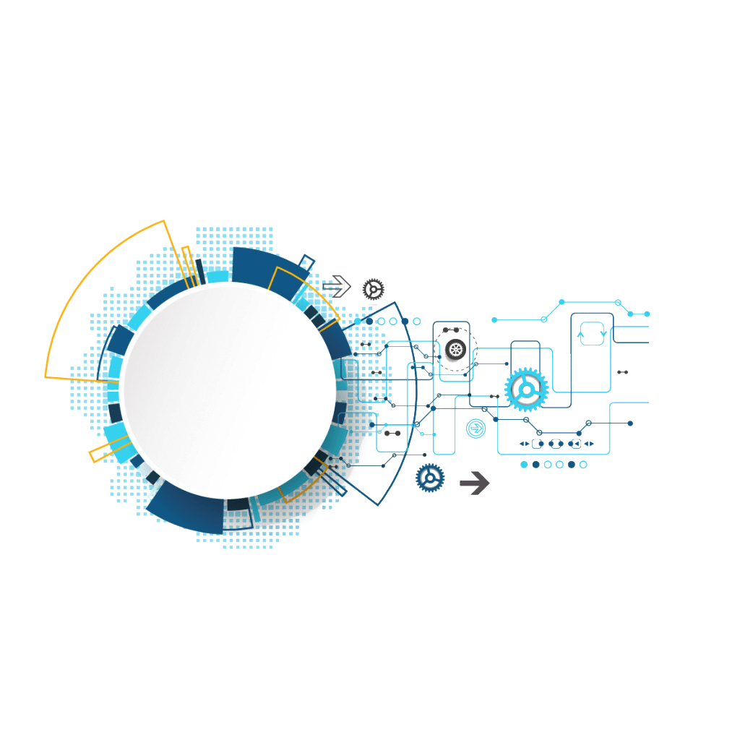

Let Computer Recognize Your Face
Deep Learning for Industrial Applications
張閔翔 Min-Hsiang Chang
吳泓毅 Hung-Yi Wu
台灣科技大學

Slide 2
Introduction
Project details
Database
Issue
Data imbalance
Improve
Data augmentation
Loss function
Result
Conclusion
Outline

Slide 3
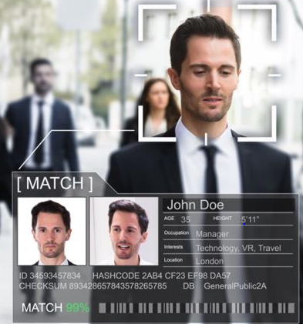
INTRODUCTION
The development of science has made human life more convenient. Delivering heavy and monotonous work to the computer can focus on more meaningful places.
Face recognition is an important part in the surveillance system and is related to the accuracy of the system.

Slide 4



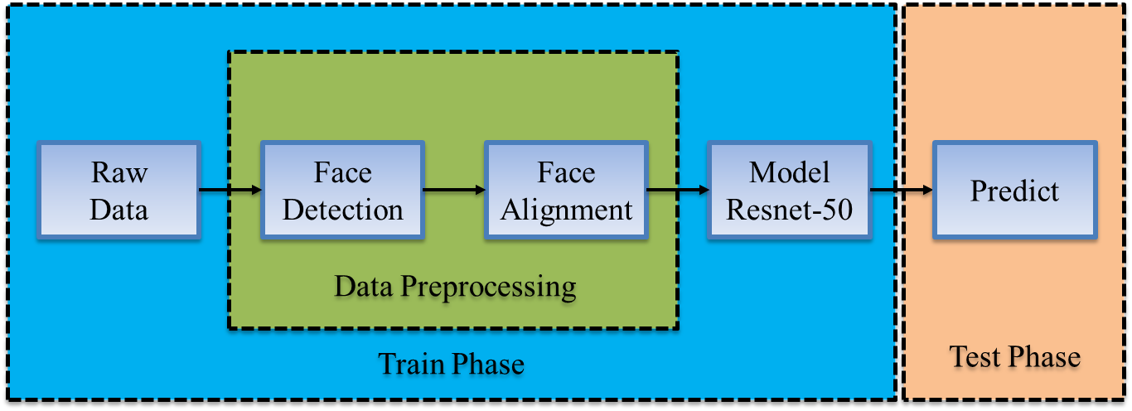

Project details
Tools : Pytorch 1.0、Matlab 2016
Training Database : CASIA-WebFace + Multi-PIE
Model : Resnet-50

Slide 5
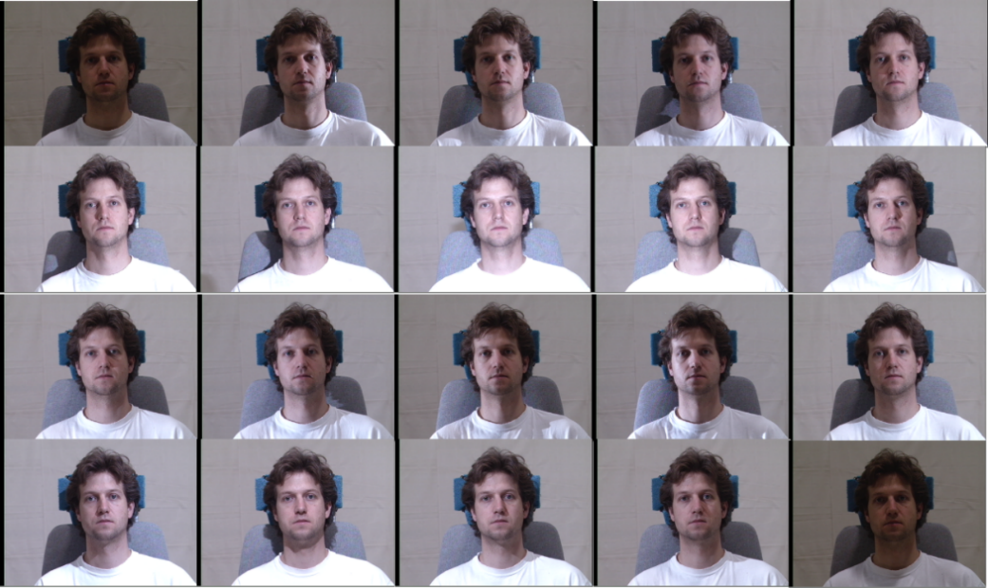
Database: Multi-PIE
In the house, taken through Session 1~4, Se. {249, 203, 230, 239}
337 subjects with more than 750k images
19 illuminations, 5 expressions, 15 poses
188 subjects for training

Slide 6
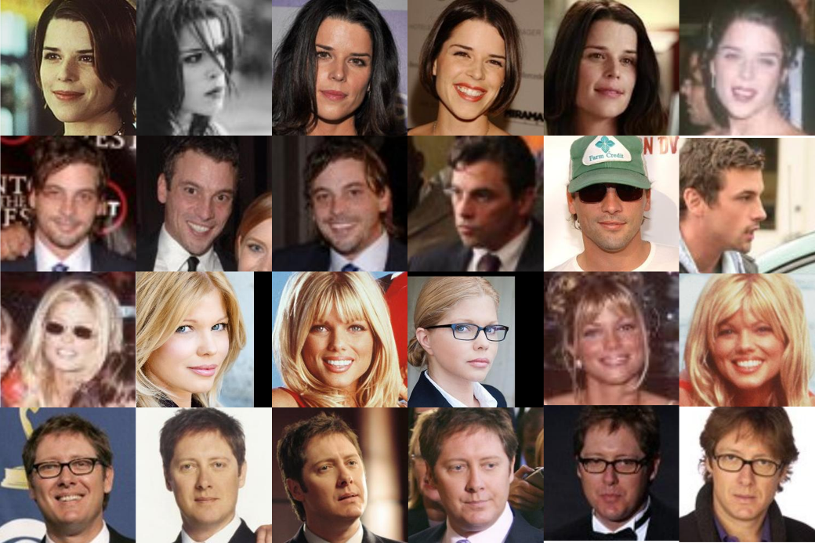
Database: CASIA-WebFace
Unconstrained environment
10,575 identities with 494,414 images
Collected from Internet Movie
Database (IMDB)
Large training data in public

Slide 7
Issue
Data imbalance
Previous
now

Slide 8
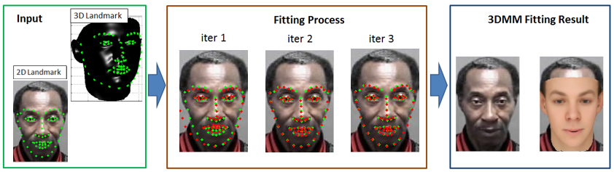
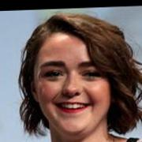
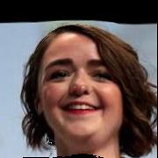
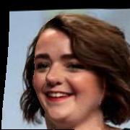
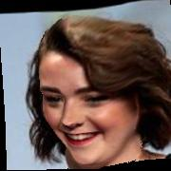
Data augmentation
3D Morphable Model (3DMM)
3D model landmark
Project
2D space
2D Face image
landmark
Fitting
Input
Pitch=20
Yaw=-45
Yaw=-45, Pitch=-20
Pitch, Yaw, Rotate
Expected picture

Slide 9
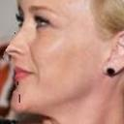
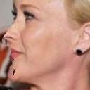
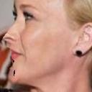
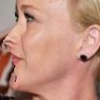
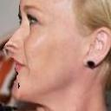
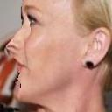


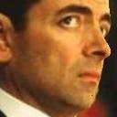
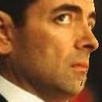
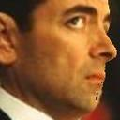
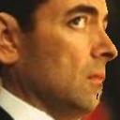
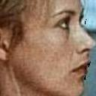
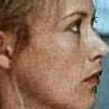
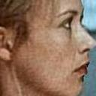
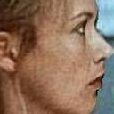
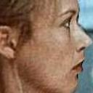
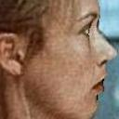




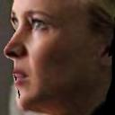
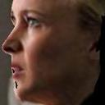



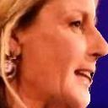


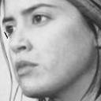
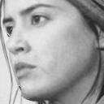
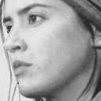
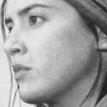
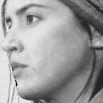
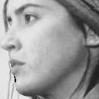
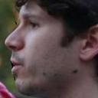

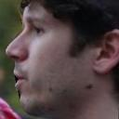
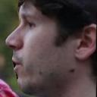
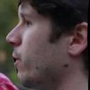
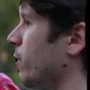





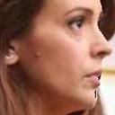
Data augmentation
65゜
70゜
75゜
80゜
85゜
90゜
45゜
50゜
55゜
60゜
65゜
70゜

Slide 10
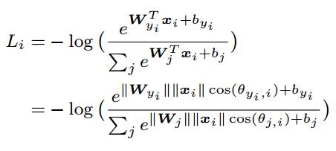
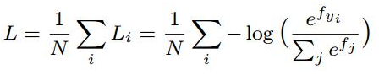
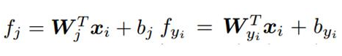
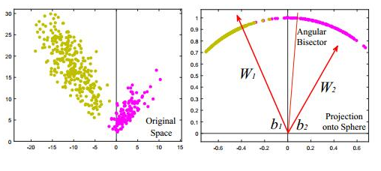
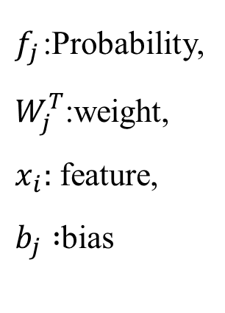
Loss function
Softmax loss function:
$f_{j}$:Probability,
$W_{j}^{T}$:weight,
$x_{i}:$ feature,
$b_{j} :$bias

Slide 11
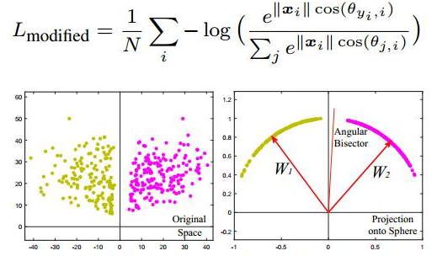
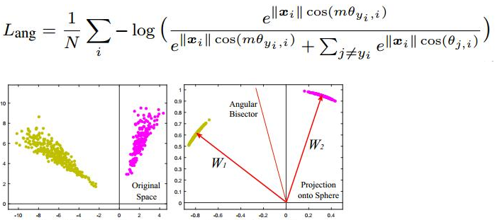
Loss function
Doing normalize and mapping to a unit sphere.
Let ||W||=1, b=0, and include angle.
Modified Softmax Loss :
On this basis, include angular margin (use m to represent it).
Angular loss :

Slide 12
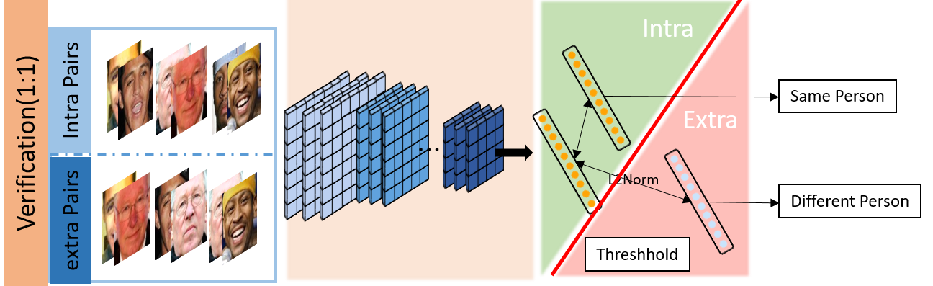
Test (Verification)

Slide 13
Result(CFP_ori)
CFP-database | Frontal to Frontal | Frontal to Profile
Ori | 89.76% | 80.68%
Augmentation 1 | 92.3% | 88.22%
Augmentation 2 | 96.1% | 89.81%
Ori(sphere loss) | 92.8% | 86.2%
Augmentation 1(sphere loss) | 95.2%. | 92.1%
Augmentation 2(sphere loss) | 97.8% | 94.7%

Slide 14
Result(CFP with our data)
CFP-database | Frontal to Frontal | Frontal to Profile
Ori | 88.62% | 78.32%
Augmentation 1 | 90.1% | 86.12%
Augmentation 2 | 94.1% | 87.26%
Ori(sphere loss) | 92.1% | 84.3%
Augmentation 1(sphere loss) | 93.8%. | 90.5%
Augmentation 2(sphere loss) | 95.2% | 92.1%

Slide 15

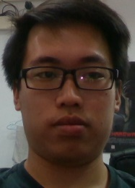








Result Analysis
Euclidean Distance
0.26
0.21
0.48
0.29
0.35
0.31
0.42
0.44

Slide 16
Conclusion
Data
Data augmentation can solve the data imbalance problem and improve our model.
Training database will decide the domain of the feature.
Loss
The better loss function can get the discriminative feature.

Slide 17


